Slide 1

Youth Wellness and Mental Health
Development Tool: Articulate Storyline
Notes:
IDOLs: Be sure to include your intended development tool so viewers of your storyboard know whether this course will be created in Storyline, Lectora, etc.

Slide 2





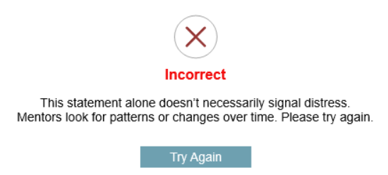
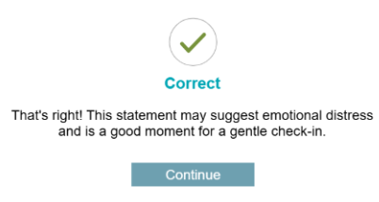
Title of Course (Arial, 40pt, Bold)
Icons
4Rs
This is the sub-heading (Arial, 20, normal)
Here is some paragraph text (Arial, 16, normal).
Youth Wellness and Mental Health for the Mentor Vermont Program.
Also use this for:
Callouts (Bold)
Button Text
Speech bubbles
Arrows
Home
Knowledge Check
Buttons
Callouts
Color Palette
incorrect feedback
Logo
correct feedback

Slide 3

Course Name: Youth Wellness and Mental Health
Module #: Welcome & Course Intro
Module Section Title (Subtopic): Welcome & Course Intro
Slide/Screen Number + Title: 1/Welcome to Youth Wellness and Mental Health
Navigation + Interactivity Notes: Next button ⇒ next slide
Accessibility: All narration is supported by on-screen text or a transcript. Buttons, tabs, and interactive elements are keyboard accessible and labeled for screen readers. Learners can control audio playback and navigate at their own pace.
Graphics and Slide Text: Youth Wellness and Mental Health
Narration/Voiceover/SoundFX: Welcome to the course Youth Wellness and Mental Health. Click on the next button below to continue.
Animation: Title of the course fades in with audio/narration.
Notes:
Clean Version

Slide 4

Course Name: Youth Wellness and Mental Health
Module #: Welcome & Course Intro
Module Section Title (Subtopic): Course Intro
Slide/Screen Number + Title: 2/Youth Wellness and Mental Health
Navigation + Interactivity Notes: Back button: previous slide Home button: Slide 1 (Welcome slide) Next button: next slide
Accessibility: All narration is supported by on-screen text or a transcript. Buttons, tabs, and interactive elements are keyboard accessible and labeled for screen readers. Learners can control audio playback and navigate at their own pace.
Graphics and Slide Text: Youth Wellness and Mental Health
Narration/Voiceover/SoundFX: As a volunteer mentor, you help young people feel seen, heard, and supported. This course takes you on a guided journey to recognize mental health challenges, respond with empathy, and build safe, trusting relationships. Along the way, you’ll gain practical tools to support your mentee with confidence.Many young people face challenges like stress, anxiety, or isolation. Your role as a mentor isn’t to diagnose—but to listen, notice changes, and respond with care.
Animation: 18.5 second Video introducing the course and its purpose.
Notes:
Clean Version

Slide 5
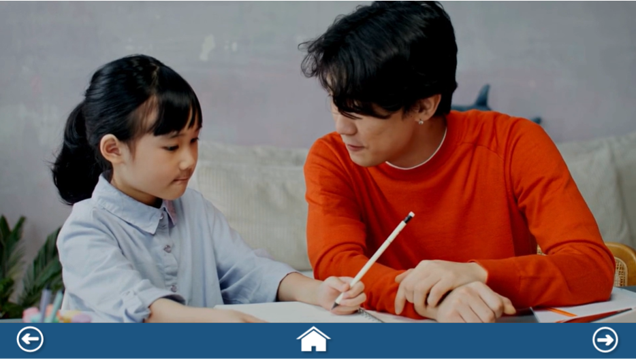
Course Name: Youth Wellness and Mental Health
Module #: Welcome & Course Intro
Module Section Title (Subtopic): Why it Matters
Slide/Screen Number + Title: 3/Context for Youth Wellness and Mental Health Course
Navigation + Interactivity Notes: Back button: previous slide Home button: Slide 1 (Welcome slide) Next button: next slide
Accessibility: All narration is supported by on-screen text or a transcript. Buttons, tabs, and interactive elements are keyboard accessible and labeled for screen readers. Learners can control audio playback and navigate at their own pace.
Graphics and Slide Text:
Narration/Voiceover/SoundFX: Narration (Script in Comment):
Animation: 55 second video giving context to the course.
Notes:
Clean Version

Slide 6
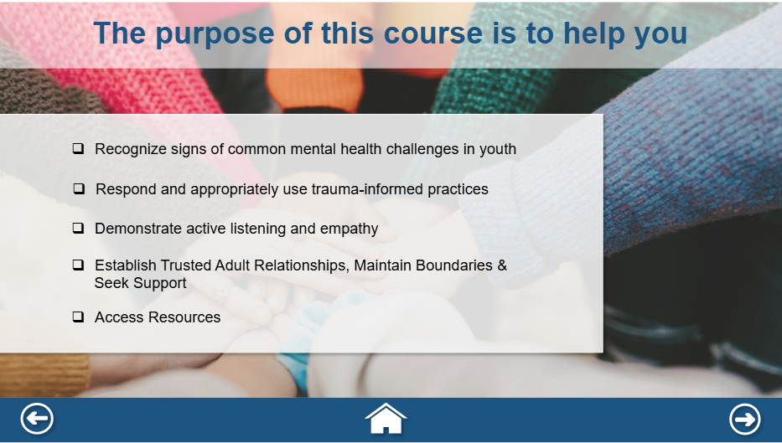
Course Name: Youth Wellness and Mental Health
Module #: Course Objectives
Module Section Title (Subtopic): Course Objectives
Slide/Screen Number + Title: 4/Purpose of this Course
Navigation + Interactivity Notes: Back button: previous slide Home button: Slide 1 (Welcome slide) Next button: module 1
Accessibility: All narration is supported by on-screen text or a transcript. Buttons, tabs, and interactive elements are keyboard accessible and labeled for screen readers. Learners can control audio playback and navigate at their own pace.
Graphics and Slide Text: The Purpose of this course is to help you
Narration/Voiceover/SoundFX: The purpose of this course is to help you: Recognize signs of common mental health challenges in youth. Respond and appropriately use trauma-informed practices. Demonstrate active listening and empathy. Establish Trusted Adult Relationships, Maintain Boundaries & Seek Support And Access Resources. Click on the next button to continue.
Animation: Transparent (60%) rectangle fades in. Then each bullet point fades in time with audio narration.
Notes:
Clean Version

Slide 7
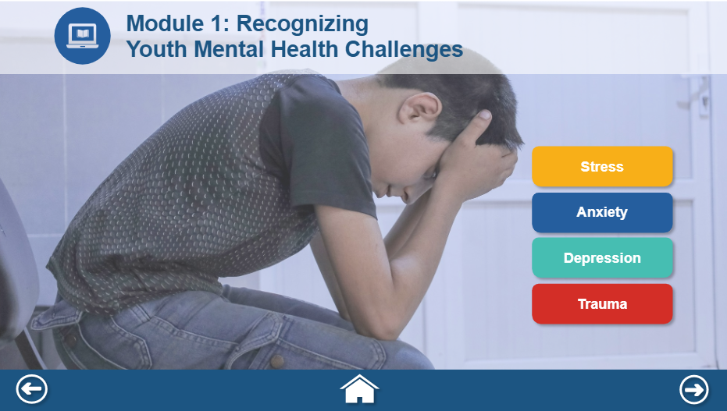
Course Name: Youth Wellness and Mental Health
Module #1: Recognizing Youth Mental Health Challenges
Module Section Title (Subtopic): Why it Matters
Slide/Screen Number + Title: 5a/Module 1: Recognizing Youth Mental Health Challenges
Navigation + Interactivity Notes: Back button: previous slide Home button: Slide 1 (Welcome slide) Next button: next slide
Accessibility: All narration is supported by on-screen text or a transcript. Buttons, tabs, and interactive elements are keyboard accessible and labeled for screen readers. Learners can control audio playback and navigate at their own pace.
Graphics and Slide Text: Module 1: Recognizing Youth Mental Health Challenges
Narration/Voiceover/SoundFX: Recognizing signs of common mental health challenges in youth. You notice your mentee, Jamie, is unusually quiet and avoids eye contact. Something feels different. Youth express stress and emotional distress in different ways. Let’s look at some common signs you might notice. Click on each tab to learn more.
Animation:
Notes:
Clean Version

Slide 8
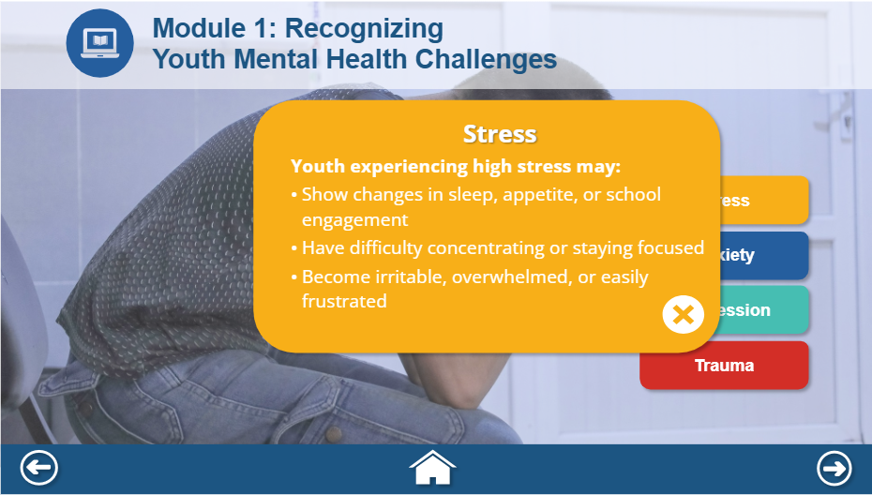
Course Name: Youth Wellness and Mental Health
Module #1: Welcome & Course Intro
Module Section Title (Subtopic): Why it Matters
Slide/Screen Number + Title: 5b/Module 1: Recognizing Youth Mental Health Challenges
Navigation + Interactivity Notes: Back button: previous slide Home button: Slide 1 (Welcome slide) Next button: next slide
Accessibility: All narration is supported by on-screen text or a transcript. Buttons, tabs, and interactive elements are keyboard accessible and labeled for screen readers. Learners can control audio playback and navigate at their own pace.
Graphics and Slide Text: Module 1: Recognizing Youth Mental Health Challenges
Narration/Voiceover/SoundFX: Narration will automatically narrate the text for each mental health challenge on each tab
Animation: Each Mental health challenge tab will fade in starting from the top to the bottom.
Notes:
Clean Version

Slide 9
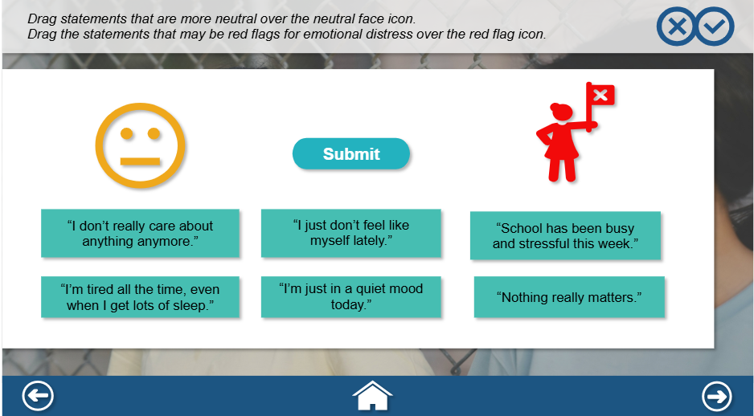
Course Name: Youth Wellness and Mental Health
Module #1: Welcome & Course Intro
Module Section Title (Subtopic): Knowledge Check
Slide/Screen Number + Title: 6/Knowledge Check Module 1
Navigation + Interactivity Notes: Back button: Module 1 (slide 5) Home button: Slide 1 (Welcome slide) Next button: next slide
Accessibility: All narration is supported by on-screen text or a transcript. Buttons, tabs, and interactive elements are keyboard accessible and labeled for screen readers. Learners can control audio playback and navigate at their own pace.
Graphics and Slide Text: Knowledge Check (Module #1)
Narration/Voiceover/SoundFX: Not every comment is a concern—but some are worth noticing. Let's see what statements are possible red flags, or maybe just everyday neutral statements. Check your understanding of recognizing common youth mental health challenges by completing this drag and drop activity. Click on the next button when you have successfully completed this activity.
Animation: Drag and drop interaction.
Notes:
Clean Version

Slide 10
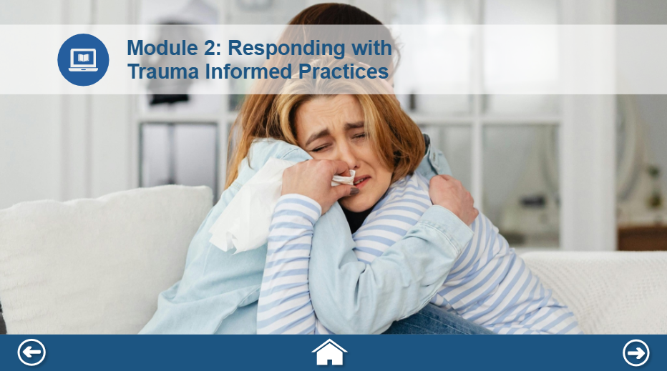
Course Name: Youth Wellness and Mental Health
Module #2: Responding with Trauma Informed Practices
Module Section Title (Subtopic):
Slide/Screen Number + Title: 7/Responding with Trauma Informed Practices
Navigation + Interactivity Notes: Back button: Module 1 (slide 5) Home button: Slide 1 (Welcome slide) Next button: next slide
Accessibility: All narration is supported by on-screen text or a transcript. Buttons, tabs, and interactive elements are keyboard accessible and labeled for screen readers. Learners can control audio playback and navigate at their own pace.
Graphics and Slide Text: Module 2: Responding with Trauma Informed Practices
Narration/Voiceover/SoundFX: Trauma-informed mentoring means realizing how trauma affects youth, recognizing signs, responding with empathy, and resisting re-traumatization. Click on the next button to continue.
Animation:
Notes:
Clean Version

Slide 11

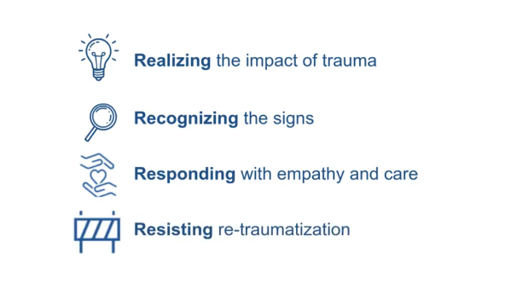
Course Name: Youth Wellness and Mental Health
Module #2: Responding with Trauma Informed Practices
Module Section Title (Subtopic):Responding with Trauma Informed Practices
Slide/Screen Number + Title: 8/Welcome to Youth Wellness and Mental Health
Navigation + Interactivity Notes: Video automatically begins and moves to the next slide when it finishes.
Accessibility: All narration is supported by on-screen text or a transcript. Buttons, tabs, and interactive elements are keyboard accessible and labeled for screen readers. Learners can control audio playback and navigate at their own pace.
Graphics and Slide Text:
Narration/Voiceover/SoundFX: Narration (Script in Comment):
Animation: 37 second video giving context to Module 2
Notes:
Clean Version

Slide 12
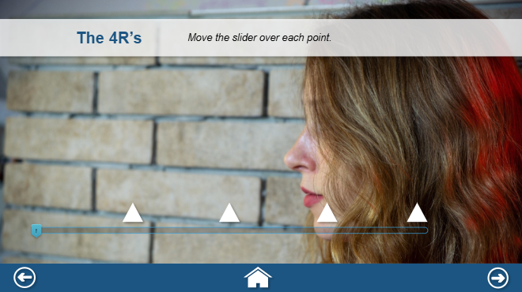
Course Name: Youth Wellness and Mental Health
Module #2: Responding with Trauma Informed Practices
Module Section Title (Subtopic): Responding with Trauma Informed Practices
Slide/Screen Number + Title: 9/Responding with Trauma Informed Practices
Navigation + Interactivity Notes: Back button: Module 1 (slide 5) Home button: Slide 1 (Welcome slide) Next button: next slide
Accessibility: All narration is supported by on-screen text or a transcript. Buttons, tabs, and interactive elements are keyboard accessible and labeled for screen readers. Learners can control audio playback and navigate at their own pace.
Graphics and Slide Text: The 4Rs
Narration/Voiceover/SoundFX: Move the slider over each point to learn more about the four R's.
Animation: Slider interaction. The learner will learn about each of the 4R’s when sliding the thumb over each point.
Notes:
Clean Version

Slide 13
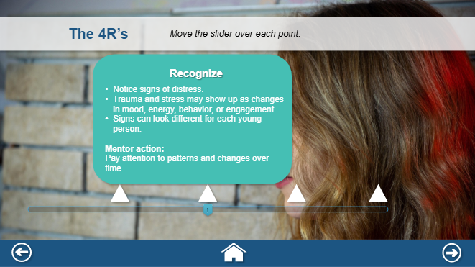
Course Name: Youth Wellness and Mental Health
Module #2: Responding with Trauma Informed Practices
Module Section Title (Subtopic): Responding with Trauma Informed Practices
Slide/Screen Number + Title: 10/Responding with Trauma Informed Practices
Navigation + Interactivity Notes: Back button: Module 1 (slide 5) Home button: Slide 1 (Welcome slide) Next button: next slide
Accessibility: All narration is supported by on-screen text or a transcript. Buttons, tabs, and interactive elements are keyboard accessible and labeled for screen readers. Learners can control audio playback and navigate at their own pace.
Graphics and Slide Text: The 4Rs
Narration/Voiceover/SoundFX: Narration will automatically start for each of the 4Rs when the learner slides the thumb to each point on the scale.
Animation: Slider interaction. The learner will learn about each of the 4R’s when sliding the thumb over each point.
Notes:
Clean Version

Slide 14
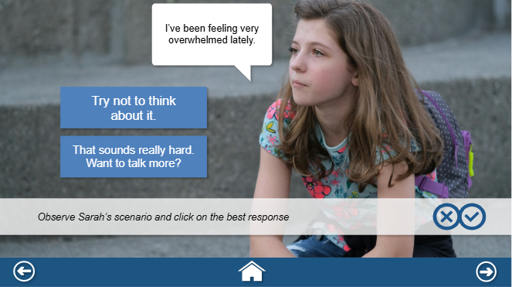
Course Name: Youth Wellness and Mental Health
Module #2: Responding with Trauma Informed Practices
Module Section Title (Subtopic): Knowledge Check
Slide/Screen Number + Title: 11/Responding with Trauma Informed Practices
Navigation + Interactivity Notes: Back button: Module 1 (slide 5) Home button: Slide 1 (Welcome slide) Next button: next slide
Accessibility: All narration is supported by on-screen text or a transcript. Buttons, tabs, and interactive elements are keyboard accessible and labeled for screen readers. Learners can control audio playback and navigate at their own pace.
Graphics and Slide Text: (Knowledge Check Module #2) Observe Sarah’s scenario and click on the best response
Narration/Voiceover/SoundFX: Sarah says: “I’ve just been feeling overwhelmed lately.” Observe Sarah’s scenario and click on the best response.
Animation: The speech bubble fades in. Then the two options fade in after for the learner to click on the best/correct response. Correct/Incorrect feedback will be given.
Notes:
Clean Version

Slide 15
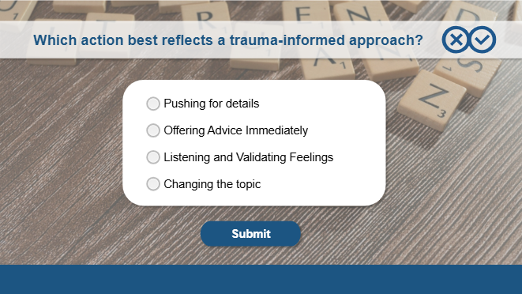
Course Name: Youth Wellness and Mental Health
Module #2: Responding with Trauma Informed Practices
Module Section Title (Subtopic): Knowledge Check
Slide/Screen Number + Title: 12a/Responding with Trauma Informed Practices
Navigation + Interactivity Notes: This slide will automatically jump to the next slide when the user clicks continue on the correct feedback.
Accessibility: All narration is supported by on-screen text or a transcript. Buttons, tabs, and interactive elements are keyboard accessible and labeled for screen readers. Learners can control audio playback and navigate at their own pace.
Graphics and Slide Text: (Knowledge Check Module #2) Which action best reflects a trauma-informed approach?
Narration/Voiceover/SoundFX:
Animation: Multiple Choice interaction Correct/incorrect feedback given
Notes:
Clean Version

Slide 16
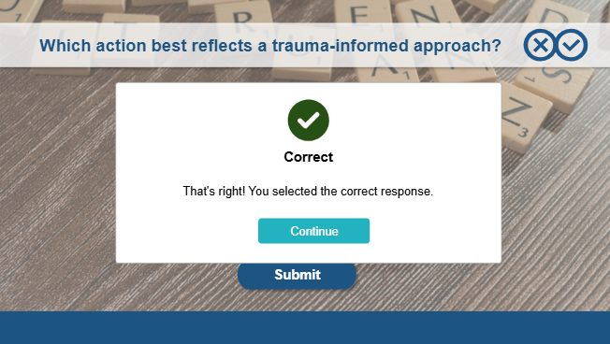
Course Name: Youth Wellness and Mental Health
Module #2: Responding with Trauma Informed Practices
Module Section Title (Subtopic): Responding with Trauma Informed Practices
Slide/Screen Number + Title: 12b/Responding with Trauma Informed Practices
Navigation + Interactivity Notes: This slide will automatically jump to the next slide when the user clicks continue on the correct feedback.
Accessibility: All narration is supported by on-screen text or a transcript. Buttons, tabs, and interactive elements are keyboard accessible and labeled for screen readers. Learners can control audio playback and navigate at their own pace.
Graphics and Slide Text:
Narration/Voiceover/SoundFX:
Animation:
Notes:
Clean Version

Slide 17
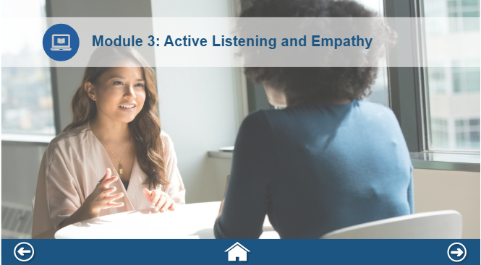
Course Name: Youth Wellness and Mental Health
Module #3: Active Listening and Empathy
Module Section Title (Subtopic):
Slide/Screen Number + Title: 13/Active Listening and Empathy
Navigation + Interactivity Notes: Back button: Module 2 (slide 7) Home button: Slide 1 (Welcome slide) Next button: next slide
Accessibility: All narration is supported by on-screen text or a transcript. Buttons, tabs, and interactive elements are keyboard accessible and labeled for screen readers. Learners can control audio playback and navigate at their own pace.
Graphics and Slide Text: Module 3: Active Listening and Empathy
Narration/Voiceover/SoundFX:
Animation:
Notes:
Clean Version

Slide 18

Course Name: Youth Wellness and Mental Health
Module #3: Active Listening and Empathy
Module Section Title (Subtopic):
Slide/Screen Number + Title: 14/Active Listening and Empathy
Navigation + Interactivity Notes: Video automatically begins and moves to the next slide when it finishes.
Accessibility: All narration is supported by on-screen text or a transcript. Buttons, tabs, and interactive elements are keyboard accessible and labeled for screen readers. Learners can control audio playback and navigate at their own pace.
Graphics and Slide Text:
Narration/Voiceover/SoundFX: Narration (Script in Comment):
Animation: 30 second video giving context to Module 3.
Notes:
Clean Version

Slide 19
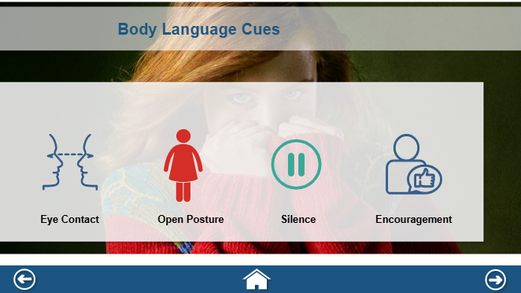
Course Name: Youth Wellness and Mental Health
Module #3: Active Listening and Empathy
Module Section Title (Subtopic):
Slide/Screen Number + Title: 15a/Active Listening and Empathy
Navigation + Interactivity Notes: Back button: Module 2 (slide 7) Home button: Slide 1 (Welcome slide) Next button: next slide
Accessibility: All narration is supported by on-screen text or a transcript. Buttons, tabs, and interactive elements are keyboard accessible and labeled for screen readers. Learners can control audio playback and navigate at their own pace.
Graphics and Slide Text: Body Language Cues
Narration/Voiceover/SoundFX: Explore each body language cue by hovering over each icon.
Animation: Hover and reveal activity. Transparent (60%) rectangle fades in. Then icons with titles fade in 1 second later. Audio narration will automatically begin when the icon is hovered over and corresponding text is audible.
Notes:
Clean Version

Slide 20
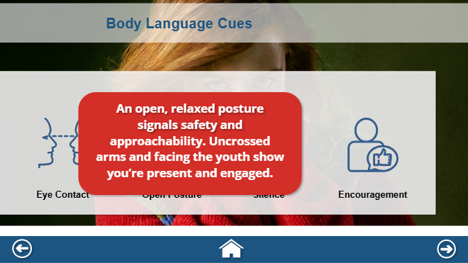
Course Name: Youth Wellness and Mental Health
Module #3: Active Listening and Empathy
Module Section Title (Subtopic):
Slide/Screen Number + Title: 15a/Active Listening and Empathy
Navigation + Interactivity Notes: Back button: Module 2 (slide 7) Home button: Slide 1 (Welcome slide) Next button: next slide
Accessibility: All narration is supported by on-screen text or a transcript. Buttons, tabs, and interactive elements are keyboard accessible and labeled for screen readers. Learners can control audio playback and navigate at their own pace.
Graphics and Slide Text: Body Language Cues
Narration/Voiceover/SoundFX:
Animation: Hover and reveal activity. Audio narration will automatically begin when the icon is hovered over and corresponding text is audible.
Notes:
Clean Version

Slide 21
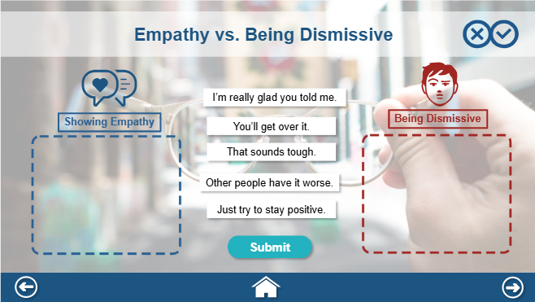
Course Name: Youth Wellness and Mental Health
Module #3: Active Listening and Empathy
Module Section Title (Subtopic):
Slide/Screen Number + Title: 16/Active Listening and Empathy
Navigation + Interactivity Notes: Back button: Module 2 (slide 7) Home button: Slide 1 (Welcome slide) Next button: next slide
Accessibility: All narration is supported by on-screen text or a transcript. Buttons, tabs, and interactive elements are keyboard accessible and labeled for screen readers. Learners can control audio playback and navigate at their own pace.
Graphics and Slide Text: (Knowledge Check Module #3) Empathy vs. Being Dismissive
Narration/Voiceover/SoundFX: Drag each statement into the correct column. Then click on the submit button to check your understanding.
Animation: Drag and drop activity. Learner must drag and drop each statement into the correct box. Correct/Incorrect/Try again feedback will be given.
Notes:
Clean Version

Slide 22
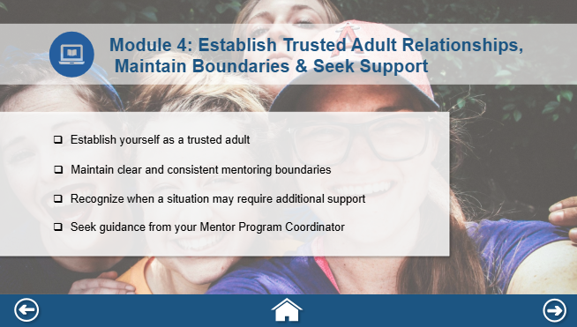
Course Name: Youth Wellness and Mental Health
Module #4: Establish Trusted Adult Relationships, Maintain Boundaries and Seek Support
Module Section Title (Subtopic):
Slide/Screen Number + Title: 17/Module 4
Navigation + Interactivity Notes: Back button: Module 3 (slide 13) Home button: Slide 1 (Welcome slide) Next button: next slide
Accessibility: All narration is supported by on-screen text or a transcript. Buttons, tabs, and interactive elements are keyboard accessible and labeled for screen readers. Learners can control audio playback and navigate at their own pace.
Graphics and Slide Text: Module 4: Establish Trusted Adult Relationships, Maintain Boundaries and Seek Support
Narration/Voiceover/SoundFX: Narration (Script in Comment):
Animation: Transparent (60%) rectangle fades in. Then each bullet point fades in time with audio narration.
Notes:
Clean Version

Slide 23
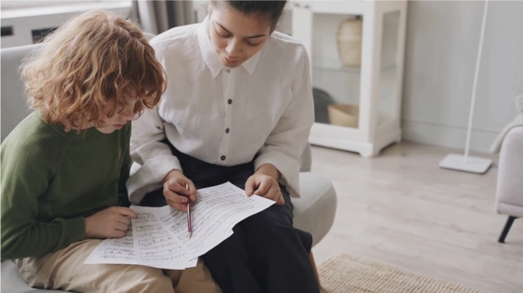
Course Name: Youth Wellness and Mental Health
Module #4: Establish Trusted Adult Relationships, Maintain Boundaries and Seek Support
Module Section Title (Subtopic):
Slide/Screen Number + Title: 18/Module 4
Navigation + Interactivity Notes: Video automatically begins and moves to the next slide when it finishes.
Accessibility: All narration is supported by on-screen text or a transcript. Buttons, tabs, and interactive elements are keyboard accessible and labeled for screen readers. Learners can control audio playback and navigate at their own pace.
Graphics and Slide Text:
Narration/Voiceover/SoundFX: Narration (Script in Comment):
Animation: 20 second video giving context to module 4.
Notes:
Clean Version

Slide 24
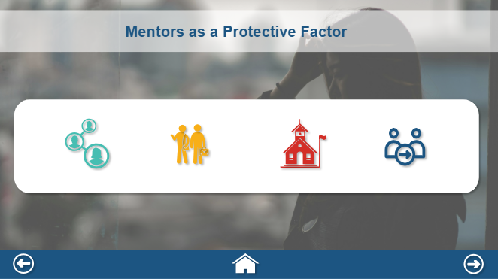
Course Name: Youth Wellness and Mental Health
Module #4: Establish Trusted Adult Relationships, Maintain Boundaries and Seek Support
Module Section Title (Subtopic):
Slide/Screen Number + Title: 19a/Module 4
Navigation + Interactivity Notes: Back button: Module 3 (slide 13) Home button: Slide 1 (Welcome slide) Next button: next slide
Accessibility: All narration is supported by on-screen text or a transcript. Buttons, tabs, and interactive elements are keyboard accessible and labeled for screen readers. Learners can control audio playback and navigate at their own pace.
Graphics and Slide Text: Mentors as a Protective Factor
Narration/Voiceover/SoundFX: Mentors are considered a protective factor for youth. Your presence matters. Sometimes you are part of a larger system of support. Other times, you may be the most consistent adult in a young person’s life. That’s why clear, consistent program boundaries are essential. They create safety, not distance. Click on each icon to learn more.
Animation: White rectangle fades in. Then icons fade in 1 second later. Click and reveal activity.
Notes:
Clean Version

Slide 25
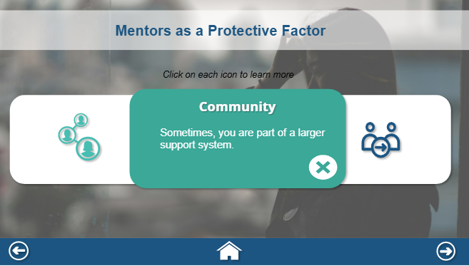
Course Name: Youth Wellness and Mental Health
Module #4: Establish Trusted Adult Relationships, Maintain Boundaries and Seek Support
Module Section Title (Subtopic):
Slide/Screen Number + Title: 19b/Module 4
Navigation + Interactivity Notes: Back button: Module 3 (slide 13) Home button: Slide 1 (Welcome slide) Next button: next slide
Accessibility: All narration is supported by on-screen text or a transcript. Buttons, tabs, and interactive elements are keyboard accessible and labeled for screen readers. Learners can control audio playback and navigate at their own pace.
Graphics and Slide Text: Mentors as a Protective Factor
Narration/Voiceover/SoundFX: Narration automatically starts when the information for each icon gets clicked on.
Animation: White rectangle fades in. Then icons fade in 1 second later. Click and reveal activity.
Notes:
Clean Version

Slide 26
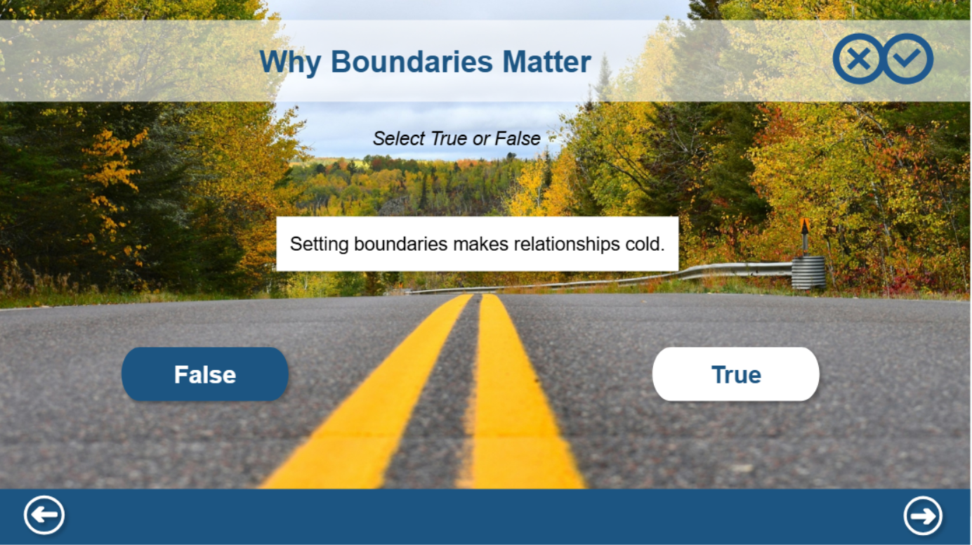
Course Name: Youth Wellness and Mental Health
Module #4: Establish Trusted Adult Relationships, Maintain Boundaries and Seek Support
Module Section Title (Subtopic):
Slide/Screen Number + Title: 20/Module 4
Navigation + Interactivity Notes: Back button: Module 3 (slide 13) Home button: Slide 1 (Welcome slide) Next button: next slide
Accessibility: All narration is supported by on-screen text or a transcript. Buttons, tabs, and interactive elements are keyboard accessible and labeled for screen readers. Learners can control audio playback and navigate at their own pace.
Graphics and Slide Text: (Knowledge Check Module #4) Why Boundaries Matter
Narration/Voiceover/SoundFX: Why Boundaries Matter. Click on True or False for the following statement. Click on the next button to continue.
Animation: True or False interaction. Correct/Incorrect Feedback is given. Learner will automatically be directed to 2nd (out of 3 total) T/F knowledge check when clicking on the continue button on correct feedback layer.
Notes:
Clean Version

Slide 27
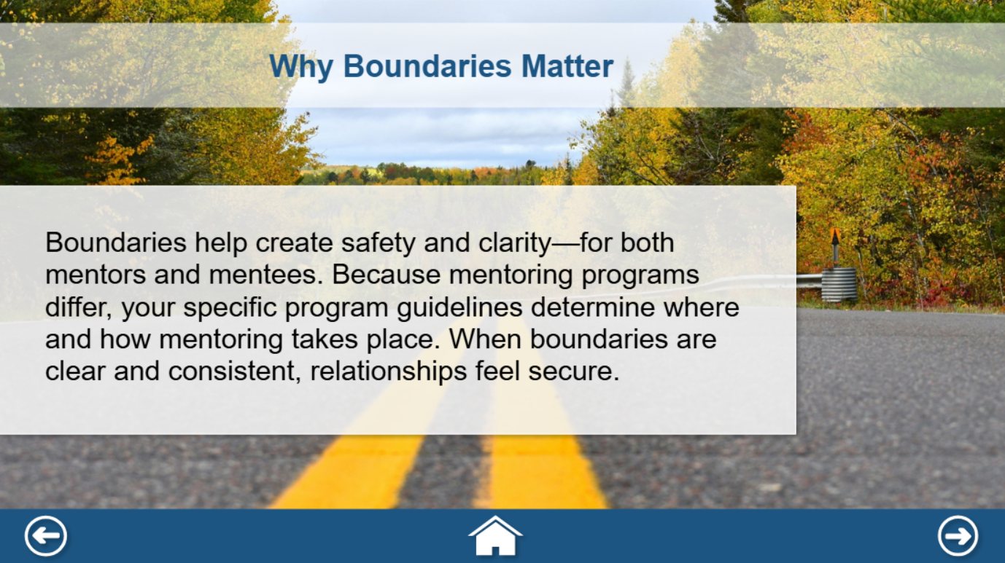
Course Name: Youth Wellness and Mental Health
Module #4: Establish Trusted Adult Relationships, Maintain Boundaries and Seek Support
Module Section Title (Subtopic):
Slide/Screen Number + Title: 21/Module 4
Navigation + Interactivity Notes: Back button: Module 3 (slide 13) Home button: Slide 1 (Welcome slide) Next button: next slide
Accessibility: All narration is supported by on-screen text or a transcript. Buttons, tabs, and interactive elements are keyboard accessible and labeled for screen readers. Learners can control audio playback and navigate at their own pace.
Graphics and Slide Text:
Narration/Voiceover/SoundFX: Boundaries help create safety and clarity—for both mentors and mentees. Because mentoring programs differ, your specific program guidelines determine where and how mentoring takes place. When boundaries are clear and consistent, relationships feel secure... Click on the next button to continue.
Animation: Transparent (60%) rectangle fades in. Text fades in time with audio narration.
Notes:
Clean Version

Slide 28
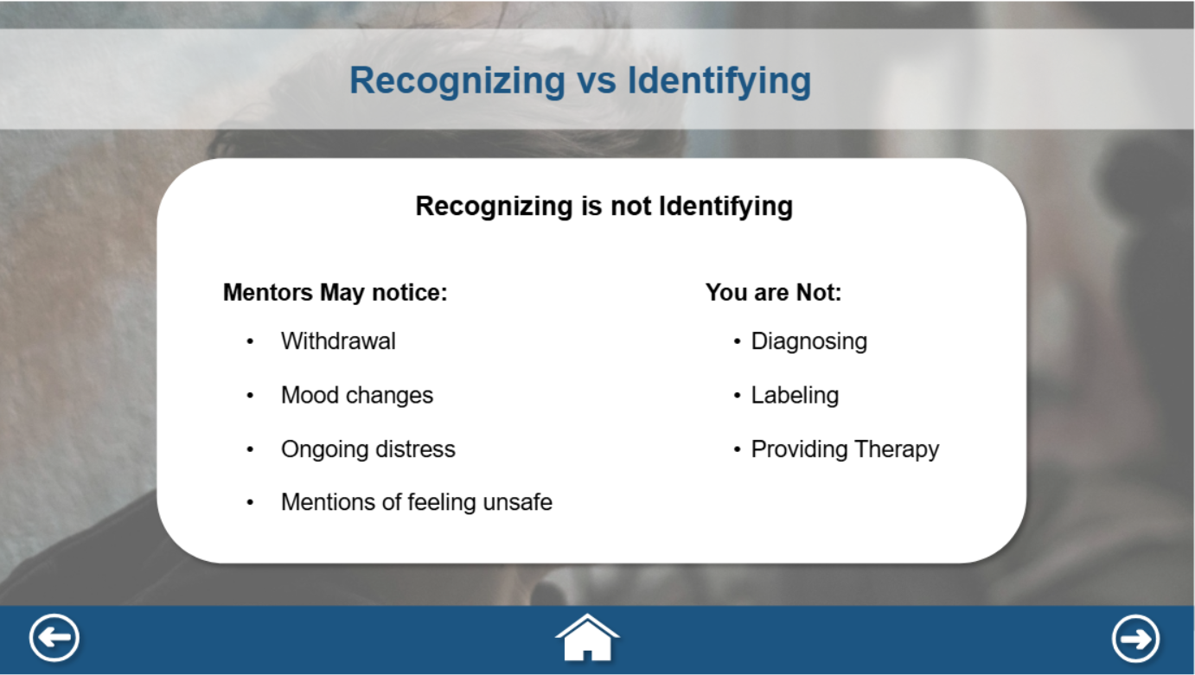
Course Name: Youth Wellness and Mental Health
Module #4: Establish Trusted Adult Relationships, Maintain Boundaries and Seek Support
Module Section Title (Subtopic):
Slide/Screen Number + Title: 22/Module 4
Navigation + Interactivity Notes: Back button: Module 3 (slide 13) Home button: Slide 1 (Welcome slide) Next button: next slide
Accessibility: All narration is supported by on-screen text or a transcript. Buttons, tabs, and interactive elements are keyboard accessible and labeled for screen readers. Learners can control audio playback and navigate at their own pace.
Graphics and Slide Text: Recognizing vs Identifying
Narration/Voiceover/SoundFX:
Animation:
Notes:
Clean Version

Slide 29
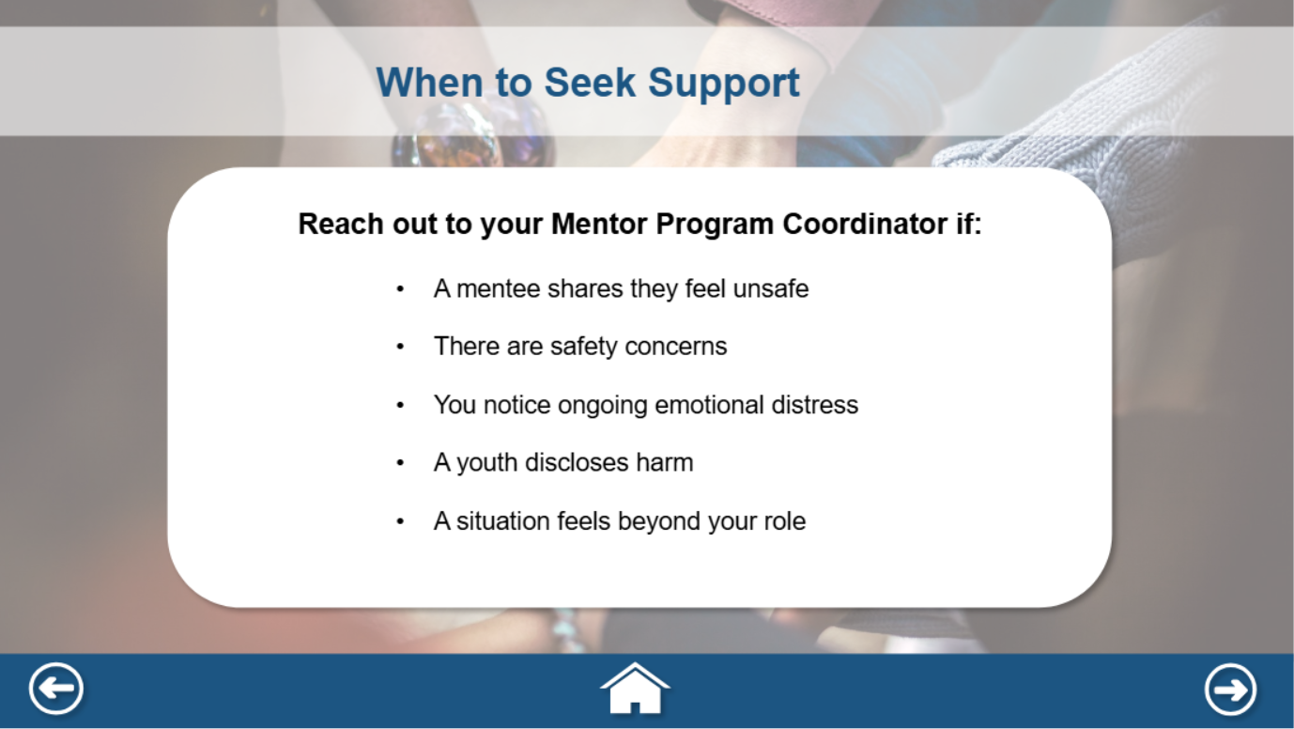
Course Name: Youth Wellness and Mental Health
Module #4: Establish Trusted Adult Relationships, Maintain Boundaries and Seek Support
Module Section Title (Subtopic):
Slide/Screen Number + Title: 23/Module 4
Navigation + Interactivity Notes: Back button: Module 3 (slide 13) Home button: Slide 1 (Welcome slide) Next button: next slide
Accessibility: All narration is supported by on-screen text or a transcript. Buttons, tabs, and interactive elements are keyboard accessible and labeled for screen readers. Learners can control audio playback and navigate at their own pace.
Graphics and Slide Text: When to Seek Support
Narration/Voiceover/SoundFX:
Animation:
Notes:
Clean Version

Slide 30
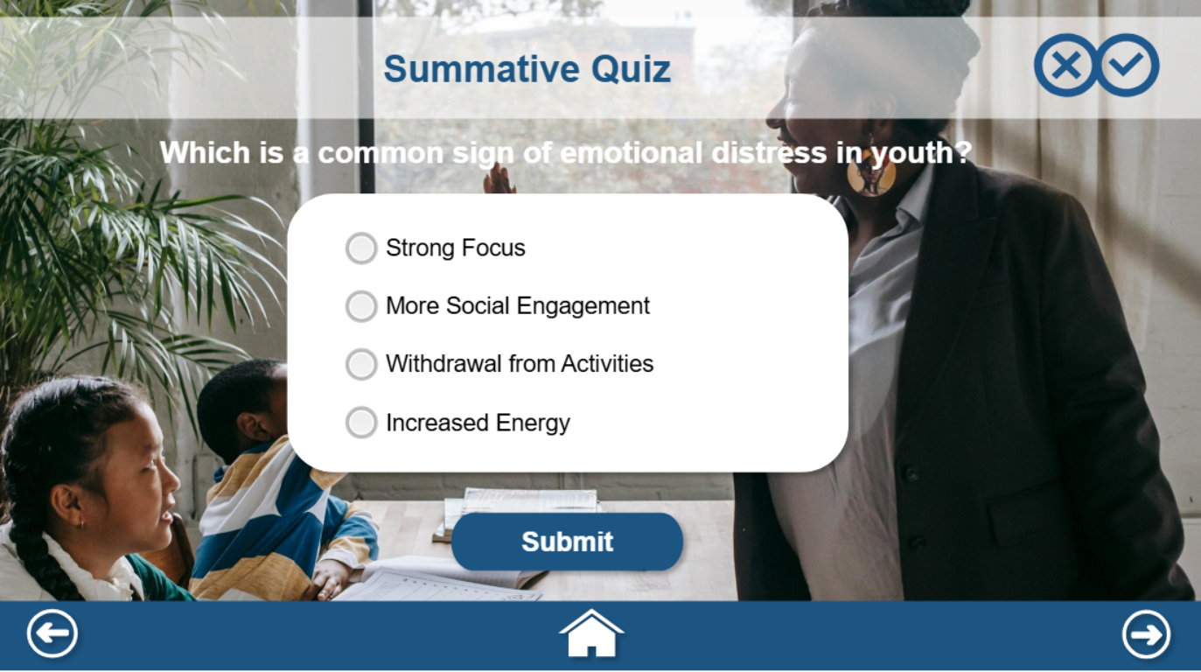
Course Name: Youth Wellness and Mental Health
Module #4: Establish Trusted Adult Relationships, Maintain Boundaries and Seek Support
Module Section Title (Subtopic):
Slide/Screen Number + Title: 24/Module 4
Navigation + Interactivity Notes: Back button: Module 3 (slide 13) Home button: Slide 1 (Welcome slide) Next button: next slide
Accessibility: All narration is supported by on-screen text or a transcript. Buttons, tabs, and interactive elements are keyboard accessible and labeled for screen readers. Learners can control audio playback and navigate at their own pace.
Graphics and Slide Text: Summative Quiz
Narration/Voiceover/SoundFX:
Animation:
Notes:
Clean Version

Slide 31
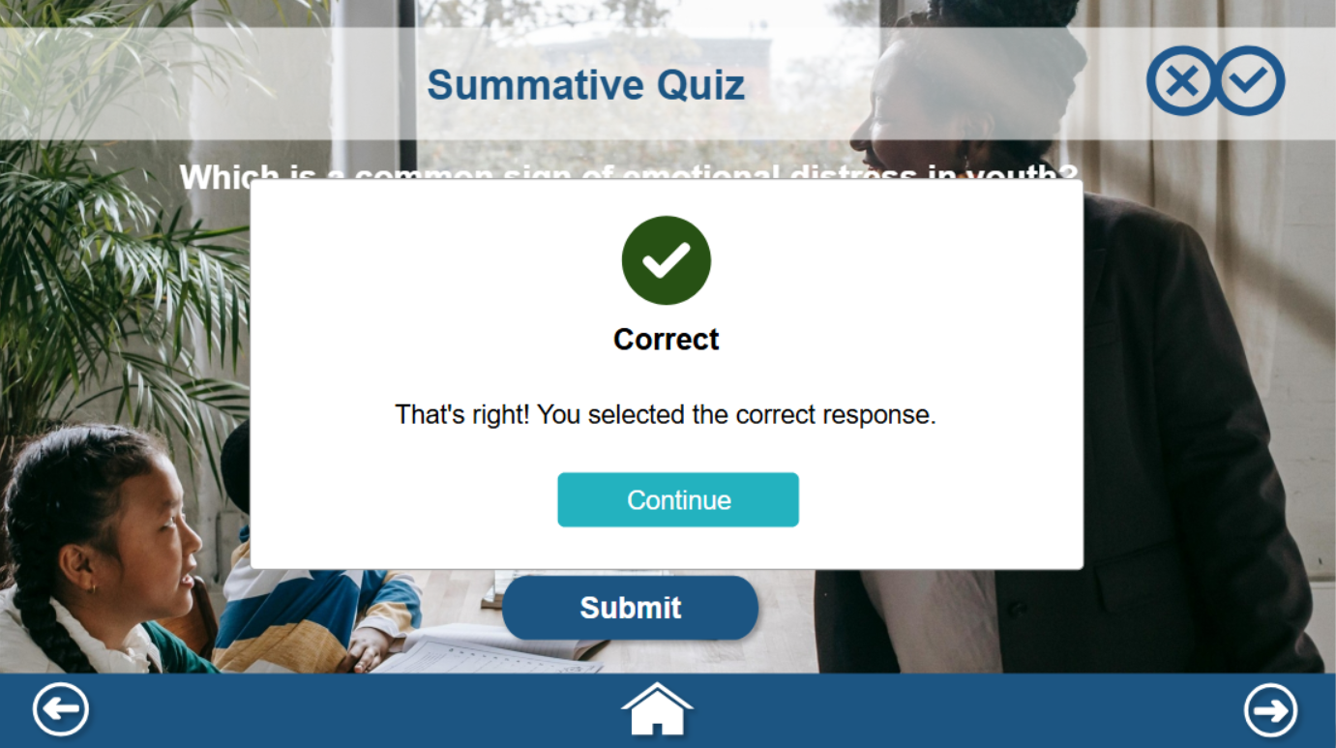
Course Name: Youth Wellness and Mental Health
Module #4: Establish Trusted Adult Relationships, Maintain Boundaries and Seek Support
Module Section Title (Subtopic):
Slide/Screen Number + Title: 25/Module 4
Navigation + Interactivity Notes: Back button: Module 3 (slide 13) Home button: Slide 1 (Welcome slide) Next button: next slide
Accessibility: All narration is supported by on-screen text or a transcript. Buttons, tabs, and interactive elements are keyboard accessible and labeled for screen readers. Learners can control audio playback and navigate at their own pace.
Graphics and Slide Text: Summative Quiz
Narration/Voiceover/SoundFX:
Animation:
Notes:
Clean Version

Slide 32

Course Name: Youth Wellness and Mental Health
Module #: Resources
Module Section Title (Subtopic): Resources
Slide/Screen Number + Title: 26/Resources
Navigation + Interactivity Notes: Back button: Module 4 (slide 13) Home button: Slide 1 (Welcome slide)
Accessibility: All narration is supported by on-screen text or a transcript. Buttons, tabs, and interactive elements are keyboard accessible and labeled for screen readers. Learners can control audio playback and navigate at their own pace.
Graphics and Slide Text: Resources
Narration/Voiceover/SoundFX:
Animation:
Notes:
Clean Version

